Slide 1
Web Based User Interface
Menu Structure

Slide 2
GOAL
Replace the current code based menu structure with a web page based menu that allows
  cleaner operator interaction
  more attractive, and current appearance
  Full functionality with main supervisory application
  Requires ZERO connectivity with outside world (local machine operation, no www access)
Menu structure is likely available from various code examples, don’t want to pay any ongoing roalties, but one time purchases are not out of the question for a code base that is useful
Web page must send and receive messages from supervisory application for data, and control response using java script. Examples provided
System will need to run OFFLINE on a windows based PC, .Net container is CHROME based

Slide 3
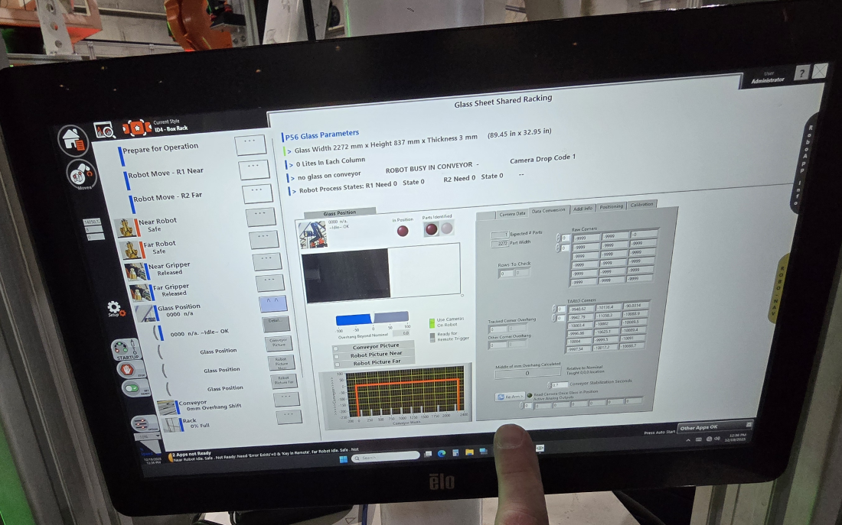
Current Functionality
Left hand menu structure

Slide 4
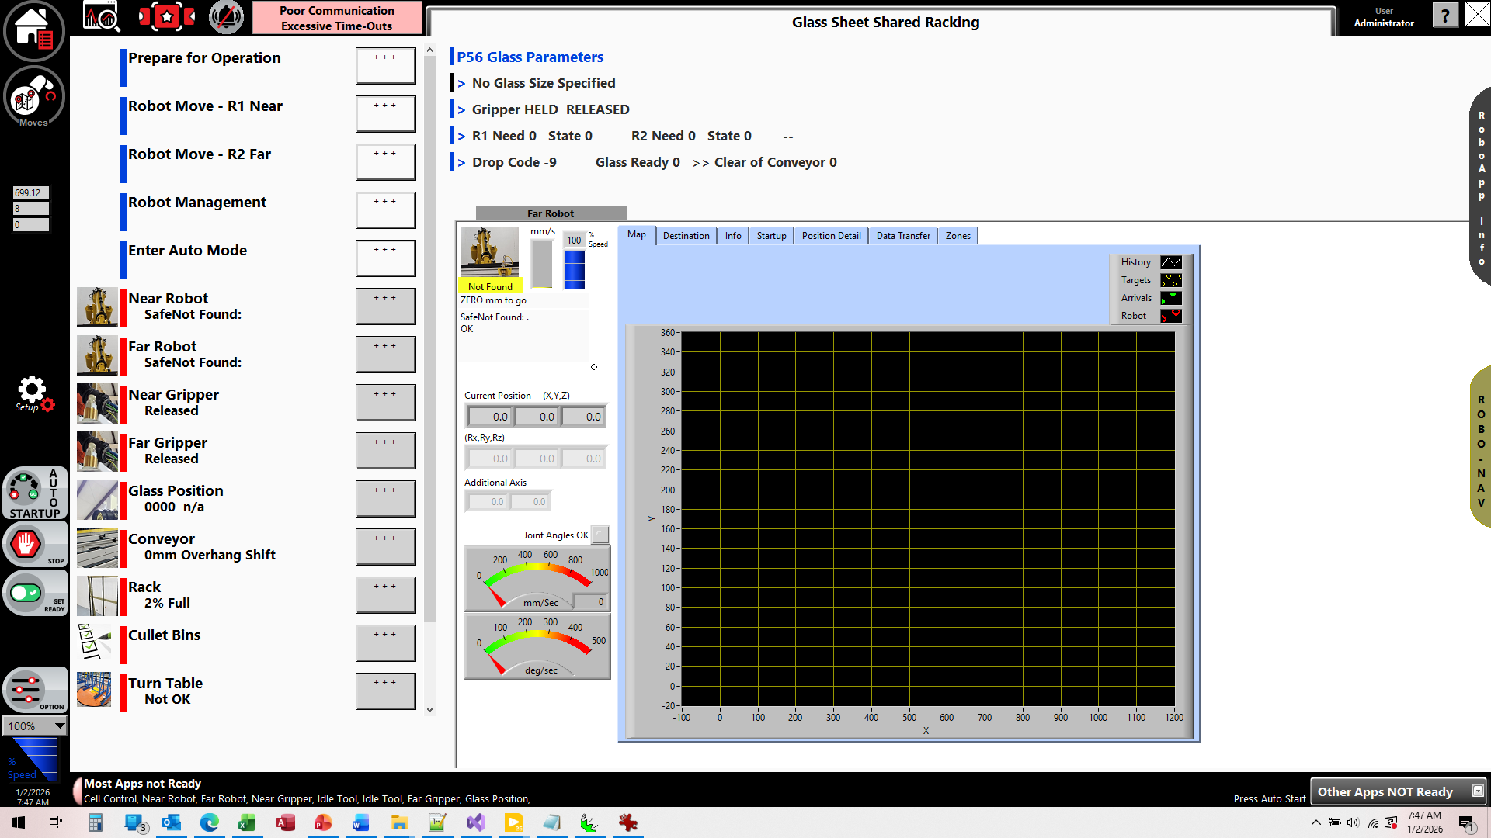
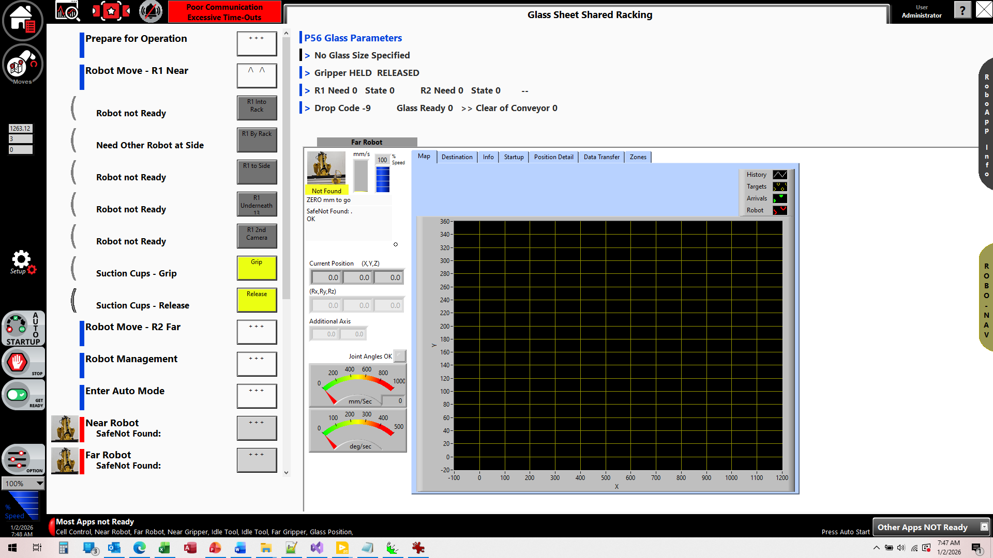
Menu Structure

Slide 5
Technical Structure
The web page will reside inside of a .Net container in a LabView (windows based) application.
The web page will reference a WebView2 code base, running a visual studio developed .Net application to house the interaction handling between the webpage and the LabView application.
The .Net interactions are tested
Required focus in on the web page, and establishing the rules for the interaction subroutines
*NO CODE* is needed to be developed for the .Net, or LabView portion. We will handle anything needed for that.
Sample web page provided
Lab View (Supervisory) Application
.Net container
Web Page Menu
Initialize
Action Request

Slide 6
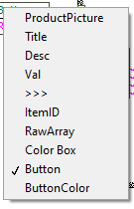
Vertical Menu
Elements for an item Appearance
Heading
Sub Text
Button
  Action Type (designates coloring/appearance)
    Menu Expansion, Detail view of Item, Device control, Robotic movement
  Button text
  Enabled
Image

Slide 7
Page Size
460 pixels wide (approx.)
Should have room for at least 10 rows in vertical of 874 pixels or so
Vertical scrolling ok, NO horizontal scrolling
Menu should show ONLY active items in category, not a full expanding list (like a phone menu where only the active group is shown, and a back or up button to return to the previous category

Slide 8
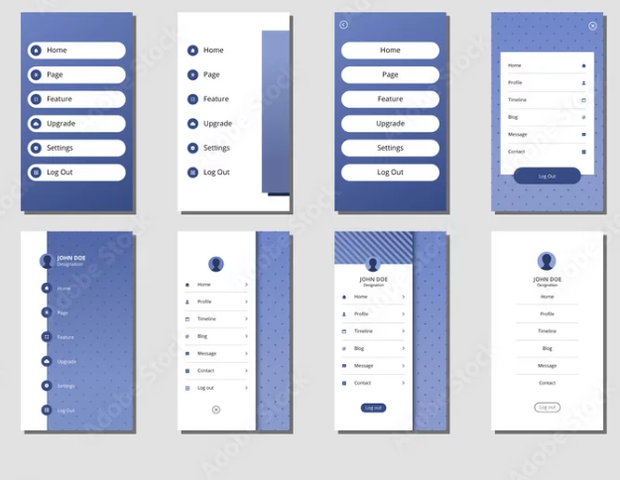
Appearance
Rounded buttons as upper left is consistent with theme of application

Slide 9
Sample web code
<!DOCTYPE html>
<html>
<head>
<title>Interactive Tree</title>
<style>
svg {
border: 1px solid #ccc;
background-color: #f9f9f9;
}
text {
font-family: sans-serif;
font-size: 12px;
pointer-events: none; /* So clicks go to the circle */
}
</style>
</head>
<body>
<h2>Interactive Tree Structure</h2>
<svg id="tree" width="800" height="400"></svg>
<script>
// -------------------------------
// RECEIVE messages from C# - was not able to get it to prouce activity on web page side
// -------------------------------
//window.chrome.webview.addEventListener('message', event => {
// console.log("C# sent:", event.data);
//
// // Show it on the page
// document.getElementById("status").innerText =
// "Received from C#: " + event.data;
//
// // Optional popup
// alert("C# senttt: " + event.data);
//});
//********************************************** Fucntions related to the tree view
const treeData = {
name: "Root",
children: [
{
name: "Child 1",
children: [
{ name: "Grandchild 1.1" },
{ name: "Grandchild 1.2" }
]
},
{
name: "Child 2",
children: [
{ name: "Grandchild 2.1" }
]
}
]
};
const svg = document.getElementById("tree");
const nodeRadius = 20;
let ySpacing = 80;
let xSpacing = 100;
let currentX = 50;
function drawNode(node, depth, parentX, parentY) {
let x = currentX;
let y = depth * ySpacing + 50;
// Draw line from parent to current node
if (parentX !== null && parentY !== null) {
const line = document.createElementNS("http://www.w3.org/2000/svg", "line");
line.setAttribute("x1", parentX);
line.setAttribute("y1", parentY);
line.setAttribute("x2", x);
line.setAttribute("y2", y);
line.setAttribute("stroke", "#555");
svg.appendChild(line);
}
// Draw node circle
const circle = document.createElementNS("http://www.w3.org/2000/svg", "circle");
circle.setAttribute("cx", x);
circle.setAttribute("cy", y);
circle.setAttribute("r", nodeRadius);
circle.setAttribute("fill", "#6fa8dc");
circle.style.cursor = "pointer";
circle.addEventListener("click", () => {
webPageActivity(node.name); //********************************<<<This needs to exist where we report back to the supervisory Robotics application
});
svg.appendChild(circle);
// Draw node label
const label = document.createElementNS("http://www.w3.org/2000/svg", "text");
label.setAttribute("x", x);
label.setAttribute("y", y + 4);
label.setAttribute("text-anchor", "middle");
label.setAttribute("fill", "#fff");
label.textContent = node.name;
svg.appendChild(label);
// Draw children
if (node.children) {
let startX = currentX;
node.children.forEach(child => {
currentX += xSpacing;
drawNode(child, depth + 1, x, y);
});
currentX = (startX + currentX - xSpacing) / 2;
}
}
drawNode(treeData, 0, null, null);
//********************************************************* the supervisory Robotics application is able to trigger any java script function with a single string as the parameter
//********************************************************* can likely do more parameters with ease as well as we pass as a full encoded string
function MABScript(messageTxt) {
alert(`You clicked onnnn: ${messageTxt}`);
}
function getGreeting(name) {
return `back at ya, ${name}!`; //***we can and need return functions for some, we see this data
}
function message(messageTxt) {
alert(`script called with parameter: ${messageTxt}`);
}
function setBackground(color) { // will likely want some visual adjustment style functions to be available
document.body.style.backgroundColor = color;
alert(`script called with parameter: ${color}`);
}
// -------------------------------
// SEND message to C#
// -------------------------------
//THIS IS THE IMPORTANT FUNCTION THAT ALL WEB PAGE ACTIVITIES NEED THAT TRIGGER EXTERNAL REAPONSIVE ACTOIVITY form the Supervisory Roboatics application
function webPageActivity(txt) {
window.chrome.webview.postMessage("MABScript was called with: " + txt);
}
/*C:\_DEVEL_\WebView2Embedder\WebView2-VS Embed-vB/WinFormsApp.sln*/
/*C:\comprehensiveROBOTICSsolution\HMI/treeviewGraphicalTest.html*/
/*C:\_DEVEL_\WebView2Embedder/WebView2Browser.vi*/
</script>
</body>
</html>

Slide 10
Interaction with Supervisory Application
From supervisory Application
Initialize display
  Sends info for list build
  Can be multiple calls, or whatever is needed to send full menu structure info
Update display
  Supervisory application will have live data and live status info for each item in the menu structure which will need to be refreshed (button enables based on status, change in subtext info, etc.)
To Supervisory Application
Button presses to trigger actions
Active sub menu (to know which nodes need to be updated for live data)

Slide 11

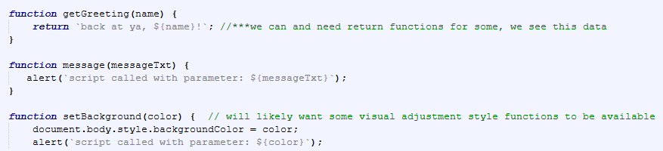
Related Code Snipents
webPageActivity(string);
  Sends a string to the supervisory application when something is clicked
  This needs to be incorporated in your menu java code
We can call (trigger) from our supervisory application any java script function. Easiest if they receive a single string as the parameter, but can send multiple parameters too as needed.
These will be for initialization and updates to the live display data

Slide 12
KICKOFF

Slide 13
PROJECT INITIATION
Each installation has a different set of Robo-Apps, and customization options
Customizable options
  This file: SmartViewLayout-Glass.csv contains the rules for the example shown in the video sent.
We also have a set of system Robo-Apps that are displayed in a menu.
  The file ModuleLayout-Glass.csv defines those.
I don’t want to change the ModuleLayout file, but I am very open to a change in the structure and definition of the SmartViewLayout file.
I am sure it can be improved to better match your menu structure, and simplify functionality.
These are files that we create, and edit when deploying a new installation
I expect that my supervisory application will be responsible to manage the subset of items that are to be in the active menu, and not make you get into the weeds of all the rules of our supervisory application, but I will give you a little background in the interest of understanding

Slide 14
Application Background
Our software platform is designed to manage robotic applications with a higher level functionality.
Instead of hard coding each step and rule, we create a set of “actions” that blend robot motion, a hand or tool for the robot, and rules for the zone.
By defining these actions as independent items, all of the software that would normally be needed to manage motion restrictions, handshaking, and mixed flow rules and sequencing are automatically generated.
By nature of this design we can move the robot in a map structure much like you would find a route to drive your car (destination based, and all the turns are automatically calculated)
The “Actions” are a combination of a robot, a TOOL Robo-App and a PROCESS Robo-App.
Each of these apps have various low level devices and functions.
The menu structure provides access to these manual/convenience controls, as well as triggering higher level actions.

Slide 15
Menu Structure Content
The Operator level AND Machine Mode filters what menu items are available (either visually, or as an enabled action)
  Operator Level - OMSCD
    Operator
    Maintenance
    Style Edit
    Config
    Display Only (no actions, not part of menu structure, but may be shown if the menu heading is active)
  Machine Mode - CPRS
    Config
    Prepare
    Running
    Service(Manual)
I can perform the filtering of the available items to put in the tree, or specify the mode and operator level that is allowed. This is part of the information in the SmartViewLayoutFile – columns A and B
Current Menu Organization
  Custom Heading
    Collection of items Under that heading
    Collection of items Under that heading
  Custom Heading 2
    Collection of items Under that heading
    Collection of items Under that heading
  Robo-Apps
    List of the visible apps
    List of the visible apps
    Background Robo-Apps
      List of the background apps
      List of the background apps
Would like to have sub menus under the headings so you can have multiple levels, right now there is just 1 level.
Each Robo-App has a set of
  Actions (higher level routines)
  Device controls (lower lever manual control of machine elements)
  Monitoring (info about the App)
When a Robo-App is selected, we currently show the detail of that app at right (large box of the LabView code front end)
  Not in scope of this project for you, but we want a much better display of the apps for generic view, this will be part of phase 2

Slide 16
Tree Needs
Would like to have sub menus under the headings so you can have multiple levels, right now there is just 1 level allowed for the configuration file
Would like to somehow mark something as a favorite and thus allow for a favorite's menu heading that would list the actions that were selected. Even better if there were a set of favorites, where each operator could add to a list (sort of like saving favorite web pages, you can throw them in a group folder)
Knowledge of what is actively displayed so we can provide dynamic updates to displays as needed, rather than continuously updating the entire tree (but not needed for fist step)

Slide 17
Menu Definition / Dynamic status
Elements for an item Appearance
Heading
Sub Text
  *Will change dynamically based on supervisory system
Button
  Action Type (designates coloring/appearance)
    Menu Expansion, Detail view of Item, Device control, Robotic movement
    See columns K and L in config file
      ROBOT MOTION
        MOVE TO,<RoboApps>\RoboApp_ConveyorPickZone.vi::Motion Loop R1::PATHEND
      DEVICE CONTROL
        <RoboApps>\RoboApp_Modbus Vac Tool.vi,Grip
        SYSTEM,Clear Alarms
  Button text
    *Will change dynamically based on supervisory system (usually due to enabled state)
  Enabled
    *Will change dynamically based on supervisory system
Image

Slide 18
FIRST STEP GOALS
Show one or more looks of the tree using these concepts, doesn’t need to work or be right, just need to get a feel for the visual. Ideally you would provide an HTML file I can drop into my system to allow it to be visible, in shape and size, ignoring all of the rules for populating and maintaining the tree.
Use this as your guide
SmartViewLayout-Glass.csv
Also Apps to Include
  ModuleLayout-Glass.csv
  The ones marked with a 5 in column F would be in the sub category of BACKGROUND Apps
    (behave a lot like a programming running that you only see through your windows service tab on your desktop, not an active program running on our desktop)
  Icons for the apps listed in column E, they are not necessarily ever a proper pixel size, but would need to auto scale for good visual. You will find these (and a bunch more legacy stuff) in the file _Graphics.zip
Please add a few extra things to show sub options, creativity welcome

Slide 19
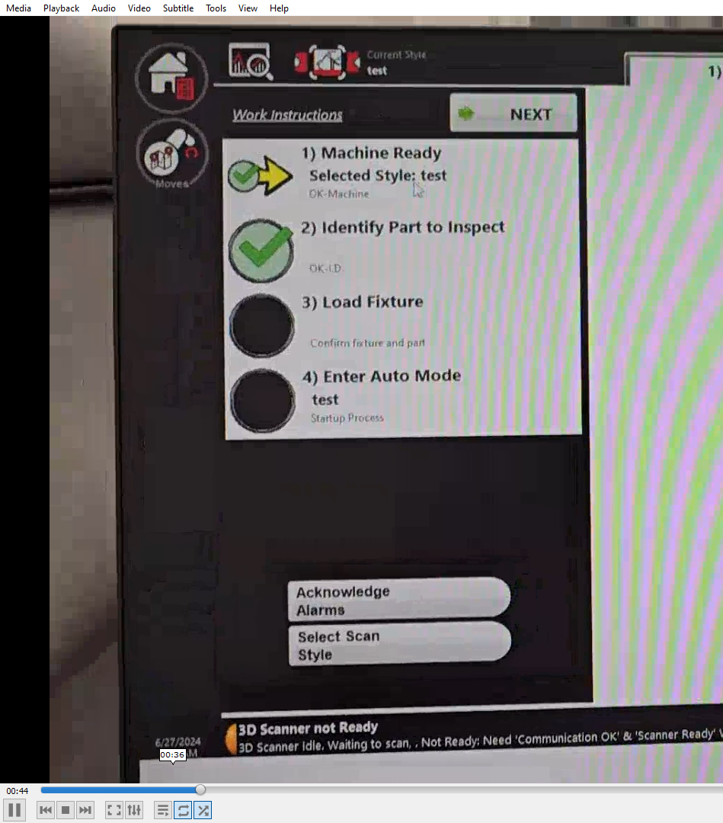
ADDITIONAL FEATURE to think about
One operator mode that we use is a CHECKLIST process.
This involves walking the operator through a series of sequential steps in order to follow the proper rules to get the machine going.
This has an additional criteria in that a mechanism of enabling the option is that the PREREQUESITE STEPS are complete
  We could identify these with a name prefix on the title, or something else.
  New columns in the configuration file (or change to the file altogether)
It would appear different, perhaps simply with an image of a check of unchecked step.

